Slide 1
Lecture 11
USE-CASE MODEL: DRAWING SYSTEM SEQUENCE DIAGRAMS

Slide 2
Agenda
Identify system events.
Create system sequence diagrams for use cases.

Slide 3
System Sequence Diagram
SYSTEM SEQUENCE DIAGRAM:-
Illustrates input and output events related to the system.
Here the system behaves as “Black Box”. Use cases describe
How actors interact with system.
Typical course of events that external actors generate.
The order of the events.

Slide 4
Sequence Diagram
A System sequence diagram visualizes a use case, while a sequence diagram visualizes a method of a class.
The elements participating (exchanging messages) in a system sequence diagram are Actors and Systems. The messages exchanged by these elements could be any type depending on the systems (from web service calls to data input from a human).
The elements participating in a sequence diagram are objects (instances of various classes). The messages exchanged by these elements are method invocations.

Slide 5
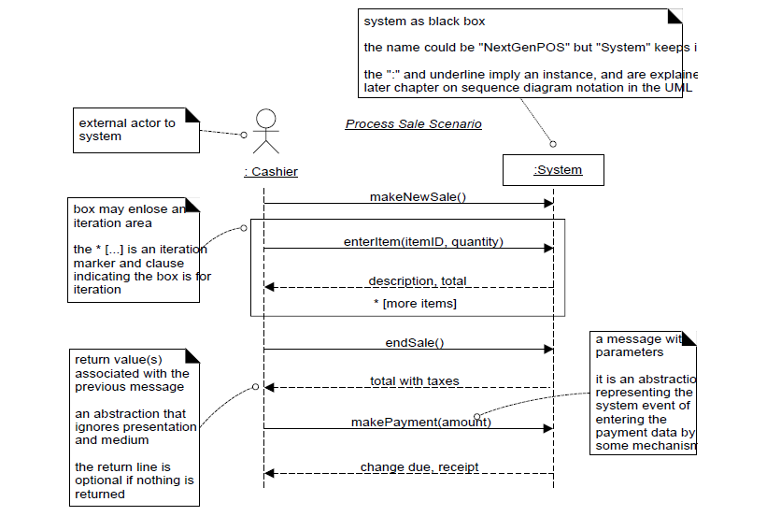

Slide 6
Phases
Inception—SSDs are not usually motivated in inception.
Elaboration—Most SSDs are created during elaboration

Slide 7
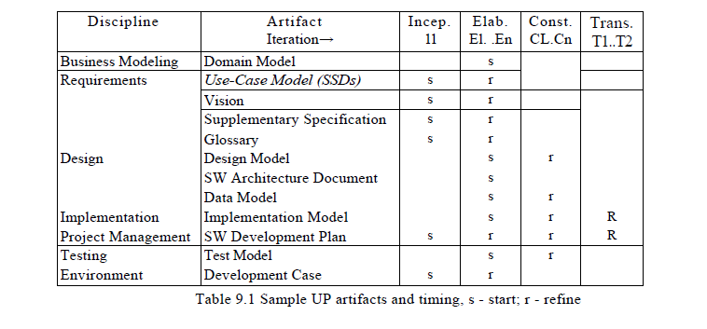

Slide 8
References
Chapter 9 Applying UML Patterns (Applying UML Patterns: An Introduction To Object-Oriented Analysis And Design) Craig L

